Slide 1
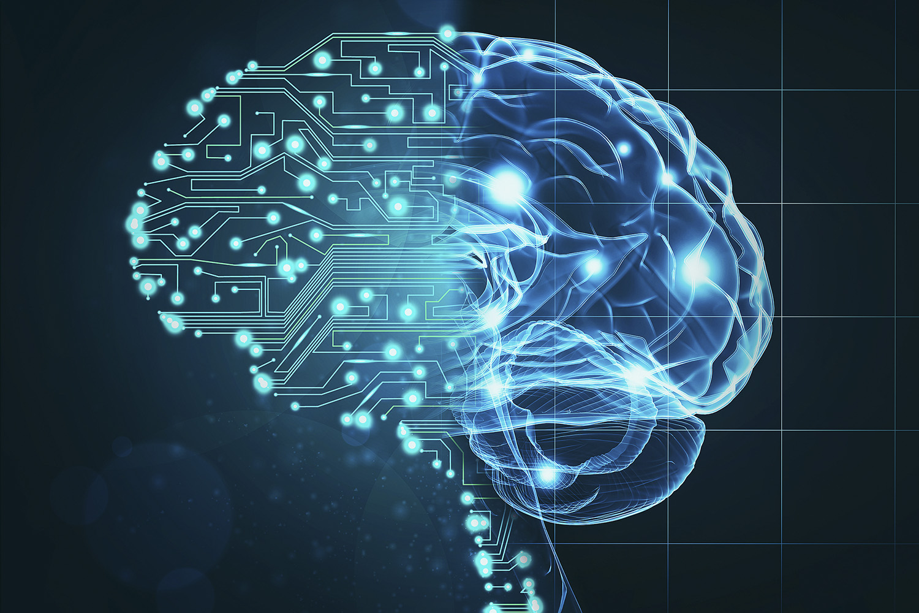
Artificial Intelligence
What is Artificial Intelligence?
Juan Uscanga
Spring 2019 – Section 1002
Juan Uscanga
Spring 2019 – Section 1002
Notes:
Intro:
Today, I wanted to talk to you guys about artificial intelligence.
I chose this topic because I felt that a lot of people are misinformed about it (as so was I).
Most people cannot perceive that artificial intelligence is already everywhere around us.
So, I will attempt to explain hat artificial intelligence is and how it works.
Hopefully by the end of this presentation you will be able to see how this new technology affects us already and how it will help shape the future.

Slide 2
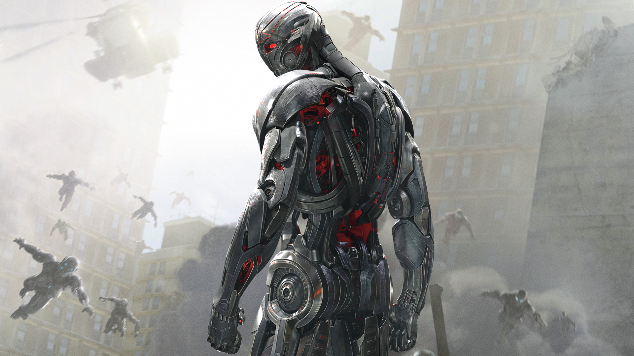
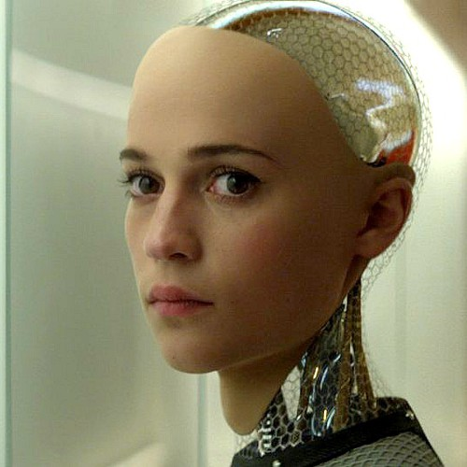
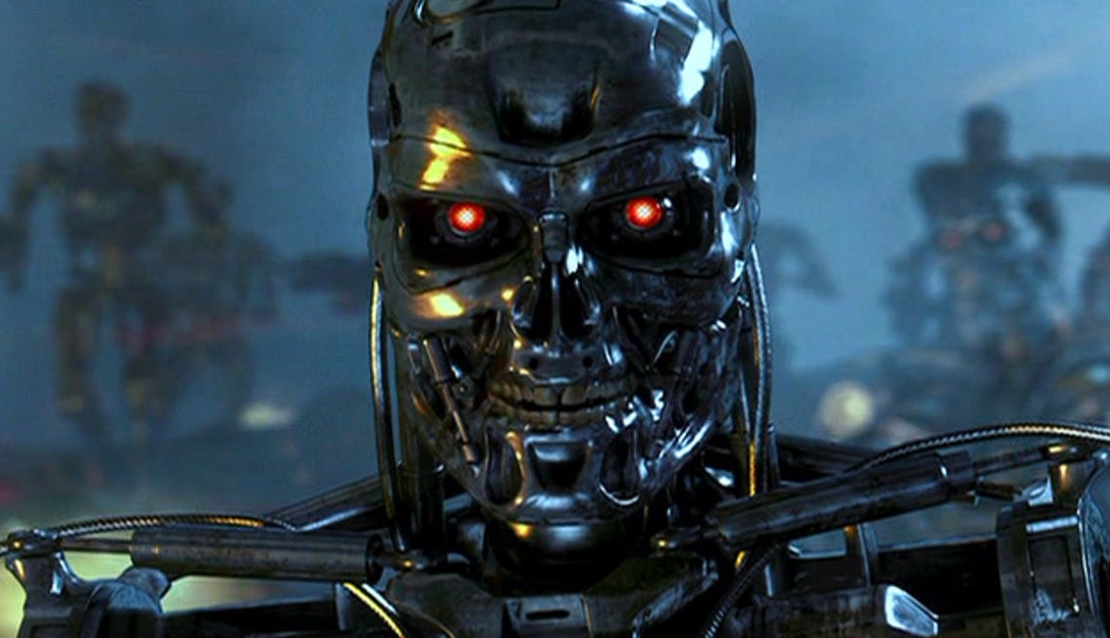
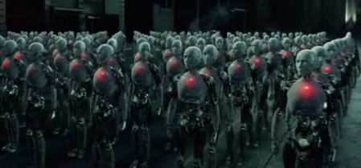
Not quite as we think…
Terminator
I, Robot
Ex_Machina
Avengers: Age of Ultron
Notes:
We all grew up watching shows and movies like… [list here]
In these films, artificial intelligence is always depicted to be human-like: full of intellect, emotion, and reason.
Usually, these A.I. beings are depicted as being super smart BUT they also tend to be depicted as evil
and with the intent of eradicating all human life from the planet.
Like most people, this was the image that was synonymous with A.I. in my head.

Slide 3
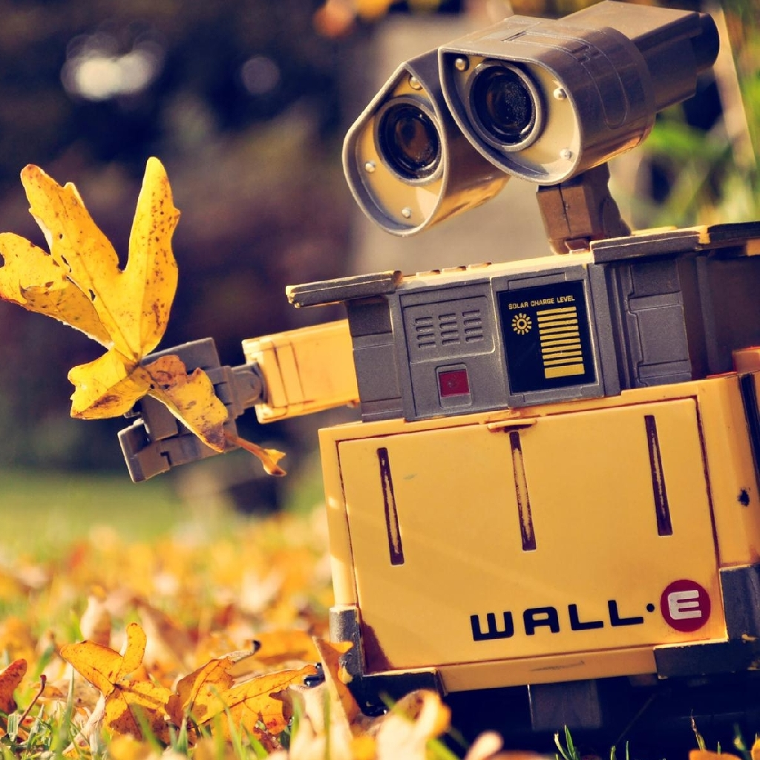


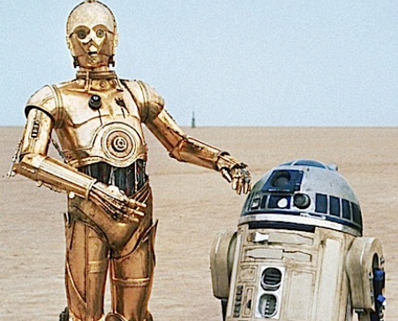
Not quite as we think…
Star Wars’ C-3PO and R2-D2
Big Hero Six’s Baymax
Avenger’s Vision
Wall-E
Notes:
I don’t think it’s bad that we are skeptical of new technologies.
It’s human nature to fear what we don’t understand.
But instead of just fearing something, we should do our jobs as individuals and get informed about these things.
Many people fail to realize that A.I. is already here, and it is being used everywhere around us.
Most A.I. implementations today are not human-like as we have been led to believe.
But they are around nonetheless, and they are already doing amazing things to help us with menial tasks as well as very complex problems.

Slide 4


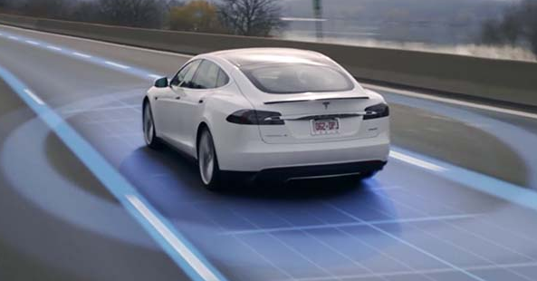
A.I. Today
Navigation and travel software
Google Maps, Airline and hotel websites
Video games
NPC’s, bots, bosses/monsters
Self-driving cars
Tesla, Mercedes-Benz, BMW, Toyota, Volkswagen, Nvidia and Samsung
Voice assistants
Google’s Assistant, Apple’s Siri, Amazon’s Alexa, and Microsoft’s Cortana
Recommendations
Amazon products, YouTube videos, Facebook Friends, Online advertisements
Notes:
We may not be able to tell but Google maps, self-driving cars, and phone voice assistants all use artificial intelligence to some extent.
Even Amazon, YouTube, Facebook, and Google all use A.I. algorithms to give you the best recommendations for products, videos, and ads.
So, what exactly is artificial intelligence then?
In order to explain what it is, we’ll have to take a detour and explore some other topics first

Slide 5

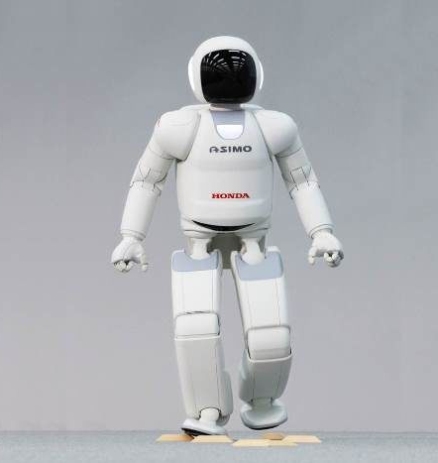
What is A.I.?
Artificial intelligence the ability for a computer or machine to imitate intelligent behaviour
What is intelligent behaviour?
We still don’t know how our minds and bodies function
How can we program these things?
Notes:
Simply put, A.I. is the ability for a computer or machine to replicate some type of intelligent human behavior
This just means that a computer is able to solve a problem that a human can
Or in some cases, solve a problem that even a human cannot
But how can we even program a machine with human-like attributes if we don’t fully understand these things ourselves?

Slide 6
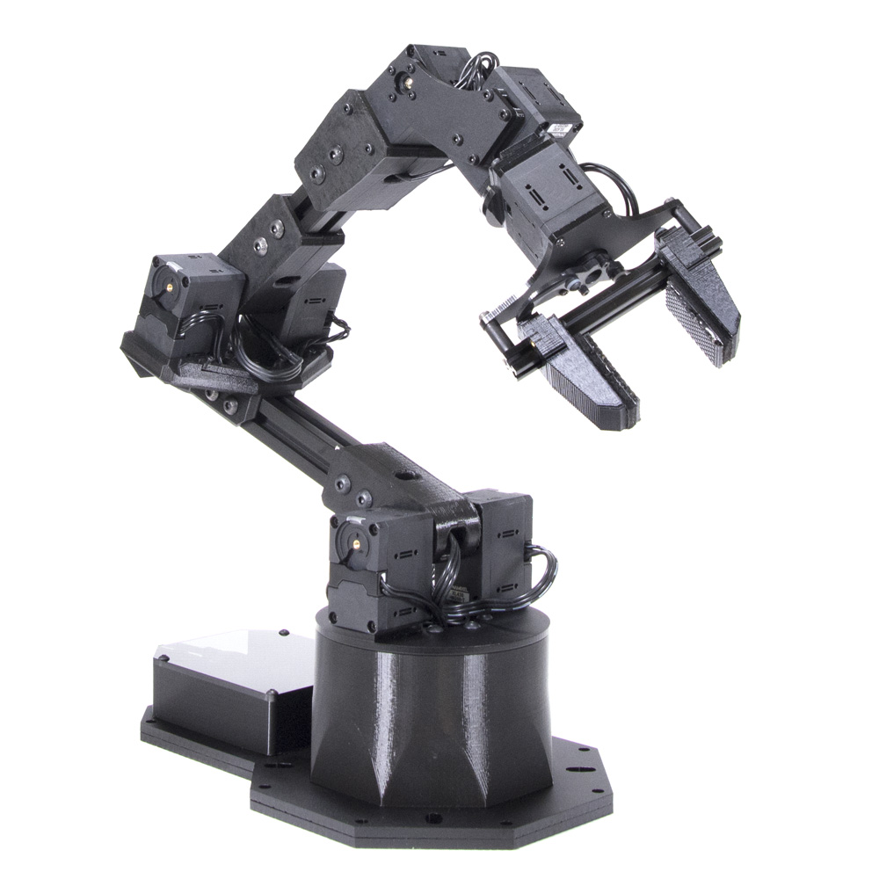
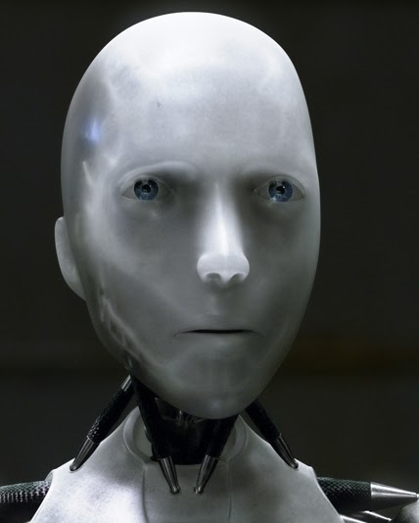
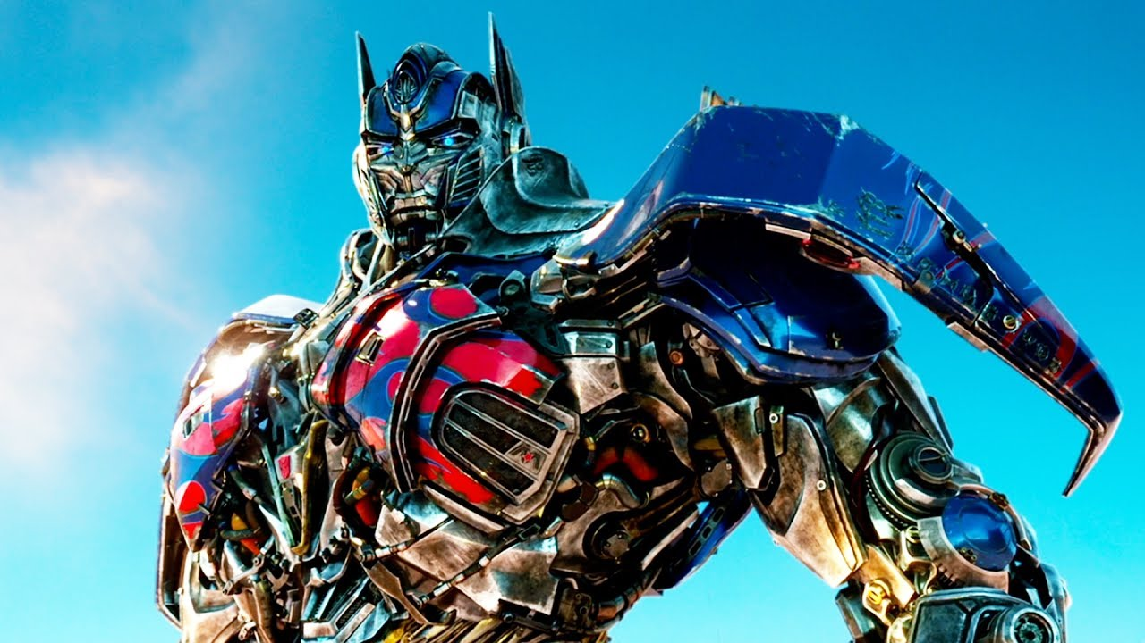
Levels of A.I.
Weak (Narrow) A.I.
Focuses on a single task
Strong (General) A.I.
Has more than one task or goal to perform
Can perform any intellectual task that a human can (exhibits human intelligence)
General (Super intelligent) A.I.
Surpasses human intelligence
Can exhibit emotion and consciousness
Notes:
Weak A.I. is the most common one today
- It focuses on a single task, like finding the fastest route
Or figuring out what would be the best friend recommendation for someone
(based on mutual friends, distance, and interests, etc.)
Strong A.I. is the next step up, on par with human intelligence
This is what most research today is focusing on now
Hence why we have neural networks and audio/visual reception
- The closes example to this today would be self-driving cars, believe it or not
General A.I. refers to the type that exhibits both human intelligence,
And can change/reprogram itself
However, this type of A.I. would also have consciousness, emotion, etc.
This is the one that we tend to think about when we watch T.V.
The kind we wouldn’t be able to tell it apart from a person if it weren’t for their mechanical bodies

Slide 7
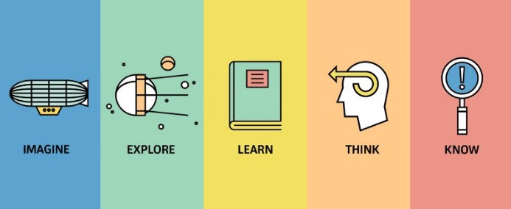
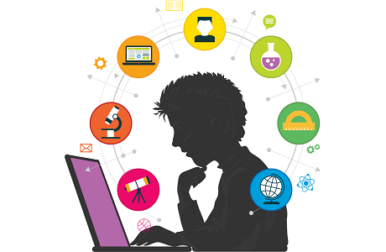
What is intelligence?
Intelligence the ability to acquire and apply knowledge and skills
Human Intelligence ability to learn from experience, adapt to new situations, understand and handle abstract concepts, and use knowledge to manipulate one’s environment
Wisdom knowledge of what is true or right, coupled with action based on judgement
(This is the next step after programming human intelligence)
Notes:
Intelligence is …
But Human Intelligence is something a bit more complicated to describe…
Ex). When someone asks you a complicated question,
you have sort through tons of seemingly unrelated
thoughts, observations and information
and then try to articulate a brief response to that question.
Even for humans, that is something that is hard to do.
You can’t just say everything you know about the related topics and hope that’ll do
Similarly, wisdom is described as…
But again, how can we even simulate wisdom if we don’t really understand what makes up consciousness or morale or emotion.

Slide 8
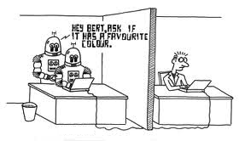

The Turing Test
Turing Test tests a machine’s ability to exhibit intelligent behavior
developed by Alan Turing (1950)
Comprised of 3 parties - An evaluator, a human, and a machine
Process:
The human and machine must hold a conversation through text only
If the evaluator, knowing that one of the parties in the conversation is a machine, cannot reliably tell the machine from the human, the machine is said to have passed the test
Machine
Human
Evaluator
Notes:
Note:
The result is not dependent on the accuracy of the machine’s answers
It is only dependent on how closely it resembles the response a human would have given
Ex). We already have so many trollbots and chatbots all over the internet today,
and it’s already hard for people to tell when they could be talking to a computer

Slide 9
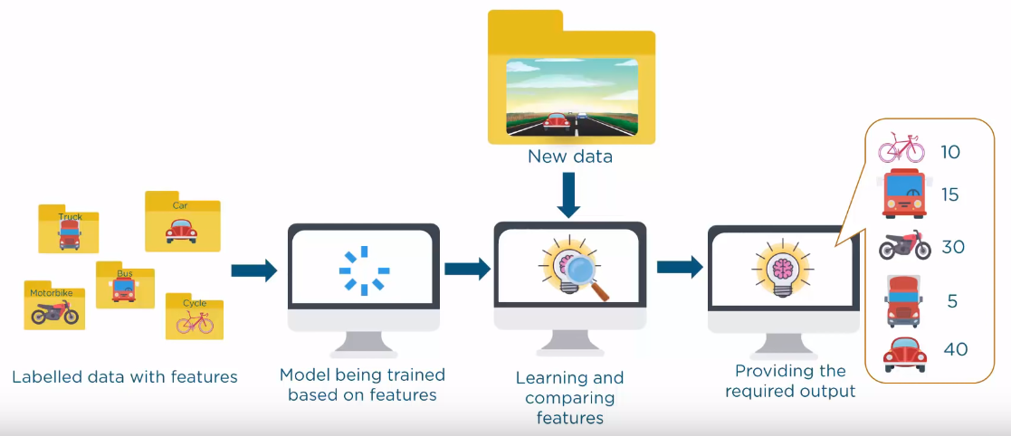
Machine Learning
Machine Learning giving computers or machines the ability to self-learn without being explicitly programmed to do so
Requires input data with known output
Ex). Humans learn from past experiences and apply that knowledge in future situations
Notes:
Moving on now, artificial intelligence has a few subsets.
2 of the most common ones that you have probably heard about are
Machine Learning and Deep Learning
Machine learning is…
Essentially, it is the idea that we can give machines data and let them learn for themselves.
Then they can apply that knowledge to solve problems or create better solutions

Slide 10
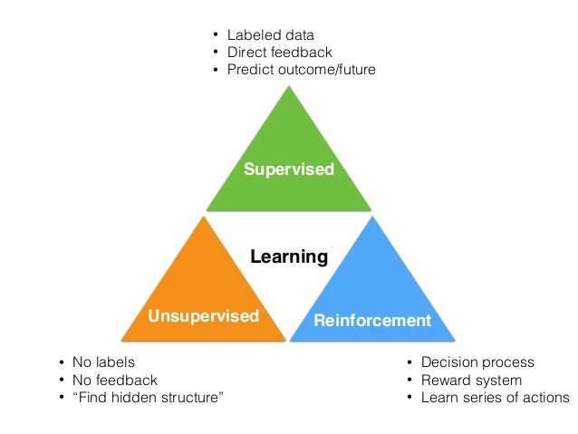
Types of learning
Supervised Learning
Able to predict future outcomes based on past data
Requires input and output in order to learn
Unsupervised Learning
Able to identify hidden patterns from provided input
Reorganizes data to make patterns, similarities, or abnormalities more evident
Reinforced Learning
Program is not given any training
Works based on a reward system
Based on the reward/punishment of its last action, it learns to adjust itself and decide what it should or shouldn’t do
Helps increase the efficiency of a tool or program
Notes:
Supervised Learning
If you give the program 100 pictures, and tell it that those are all cars,
the computers analyzes them and draws information from them.
The next time it is given any picture of a car, it will be able to tell.
Unsupervised Learning
(This is where the term clustering comes from)
Essentially, we give the program 100 pictures but don’t tell it what they are.
The program then attempts to cluster things together.
And then separates or pulls out the pictures that aren’t similar.
The result is that we get a cluster of cars, a cluster of bicycles, and another of beach balls.
Reinforcement learning
For example, based on the last action, it will be given a “yes” or “no”.
“Yes”, you gave me the right answer or “no”, you didn’t.
Based on that, it will attempt to group items differently or give a different response.
It does this over and over again until it gets the highest accuracy possible with the given data set.

Slide 11
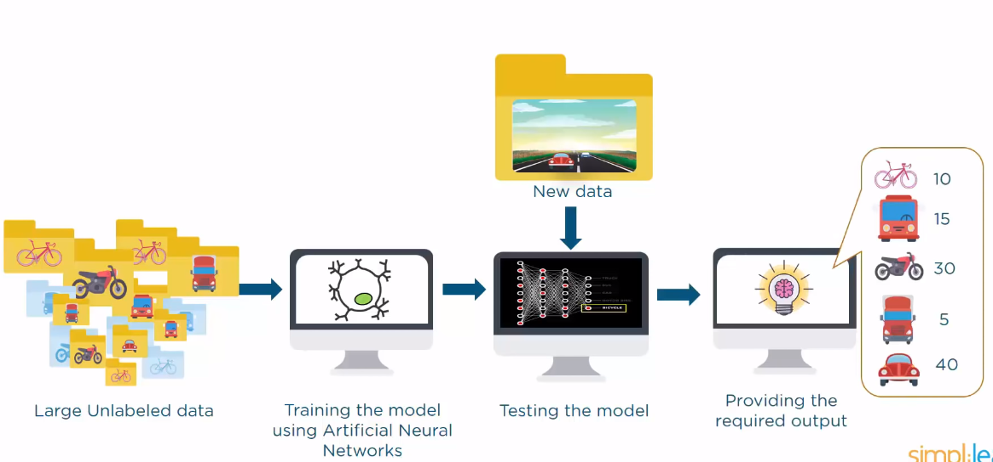
Deep Learning
Deep Learning is a technique that attempts to mimic the human brain (i.e. assimilate a human) – including cognitive abilities and data reception through physical senses
Implements artificial “neural networks”
Similar to how human brains work
Neuron the basic working unit of the brain, which transmits information to other neurons, muscles, or systems within the brain or body
Notes:
This subset of A.I. is closer to what we see on T.V.
It tries to implement artificial neural networks.
Deep learning tries to replicate neurons, where each neuron is connected to other neurons.
When a specific set of neurons fire off,
it triggers another specific set of neurons to go off (and so on).

Slide 12
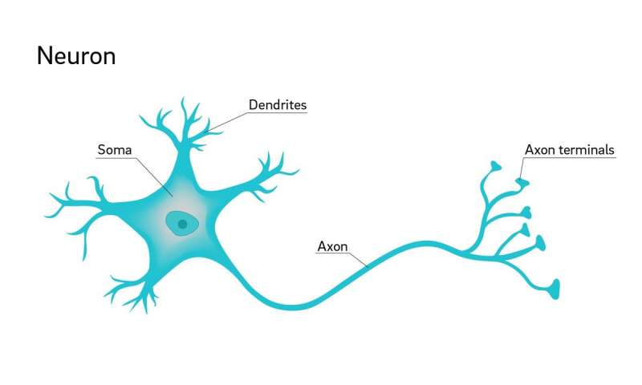
Biological Neuron
Notes:
Neurons are comprised of 3 main categories:
The Dendrites
The Axon
The Axon Terminals
The Dendrites – receives impulses from other cells.
The Axon – conducts electrical impulses away from the neuron’s cell body (soma).
The Axon Terminals – the very end of the axon, which conducts electrical signals to a nerve synapse.
The Nerve synapse – small gap at the end of an axon’s terminal, which allows a signal to pass from one neuron to the next.

Slide 13
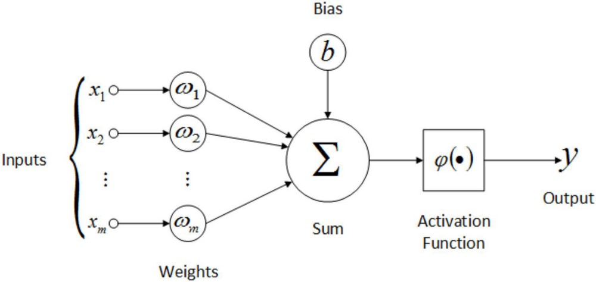
Artificial Neuron
Notes:
Similar to neurons, we can program artificial neurons to take a binary input (0 or 1).
This input is then multiplied by a specified weight.
Now, there has to be some way to determine how various input signals into the same neuron are collected.
That can be done by summing the inputs that were multiplied by weights from the previous step.
Depending on whether this sum exceeds a given threshold, the “neuron” will fire off,
sending a signal to the next set of neurons, and so forth.

Slide 14
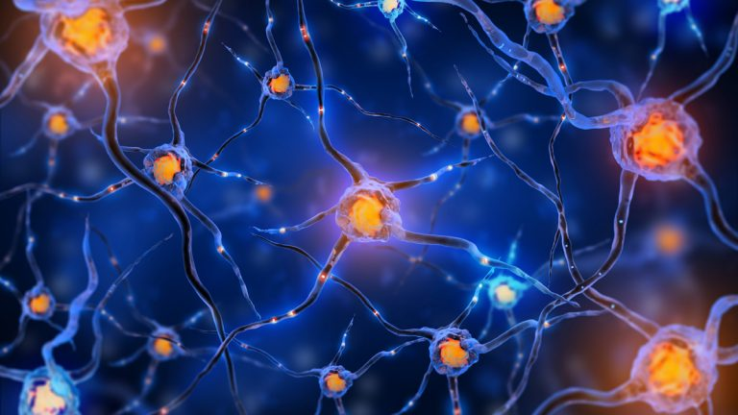
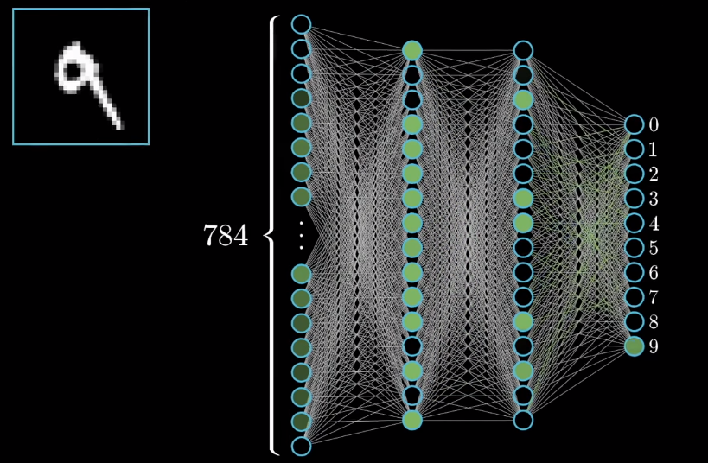
Artificial Neural Network
9
Notes:
Now, onto the bigger picture…
We can see that similar to the neural network in our brains,
an artificial one connects inputs to outputs.
Along the way, depending on the inputs, only certain neurons at the next level will fire off
(based on whether the threshold was exceeded or not).
At each step, input weights are updated, depending on some complex equations for each neuron.
So that by the last level, we can either give the output as the solution or compare it to the answer,
depending on the goal
Ex). This is used a lot in compliment of audio/visual reception.
For example, to tell what character someone wrote down.
At each level of the neural network, the image is broken down into black/white pixels.
Next, the pixels representing the number are broken down further.
Then, each part of the number broken down.
By the end, it can determine that that number was in fact a 9 and not a 3 or 6.

Slide 15

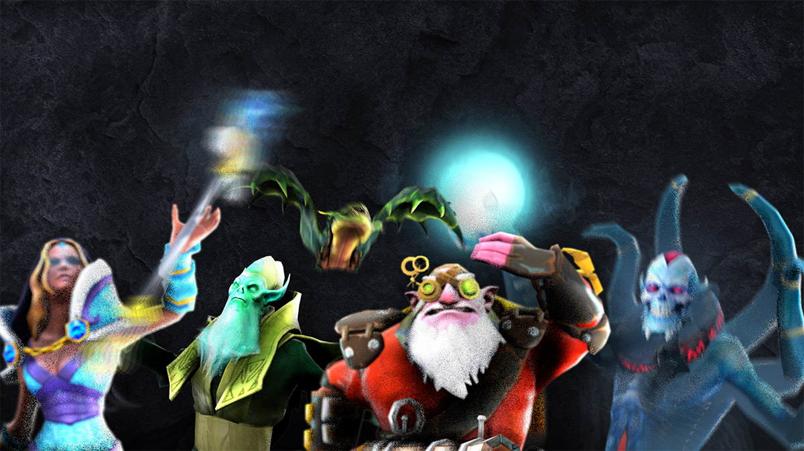
OpenAI
OpenAI is a non-profit A.I. research organization that aims to promote and develop friendly A.I. with the intent of benefiting humanity
Founded by Elon Musk and Sam Altman in 2015
Notable motivation in part by concerns about existential risk from general A.I.
OpenAI FIVE is a team of 5 openAI-curated bots used in competitive Dota 2 5 vs 5 matches.
This team of A.I. has never been beat by a team of humans in a competitive DOTA 2 match.
OpenAI 5

Slide 16

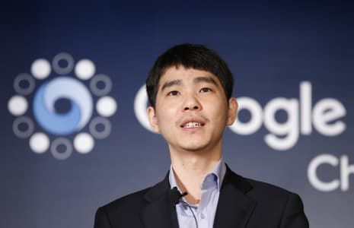
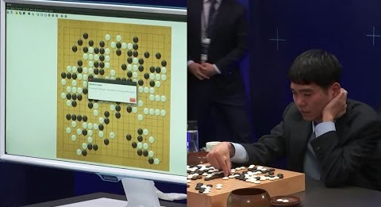
Google’s DeepMind
DeepMind is a general purpose neural network that is being applied to many fields
Learns by playing video games (like GO and StarCraft)
AlphaGo beat Go World Champion, Lee Sedol
(4-1) in March of 2016
Notes:
Recently, DeepMind was acquired by Google.
It is a global leading A.I. researching company.
Like OpenAI, it hopes to apply this research to positively impact human life.
AlphaGo used an expert system, analyzing thousands of played games and outcomes to determine the best strategies for each game it plays.

Slide 17
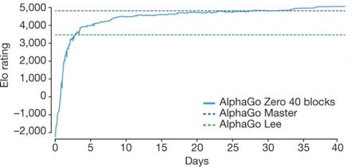
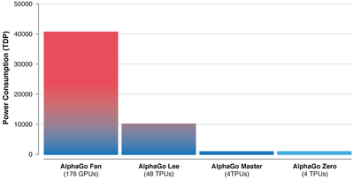
DeepMind’s AlphaGo Zero
Announced on October 2017
Does not implement an expert system
Expert System practical application of a knowledge database to solve complex problems
Beat AlphaGo (100-0)
Only given the game rules
Learned through self-play
Only had 40 days to learn

Slide 18
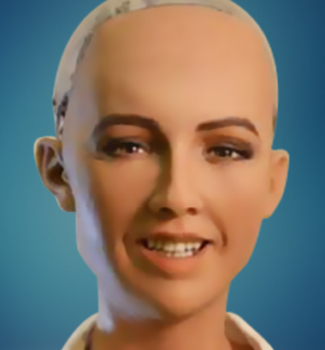
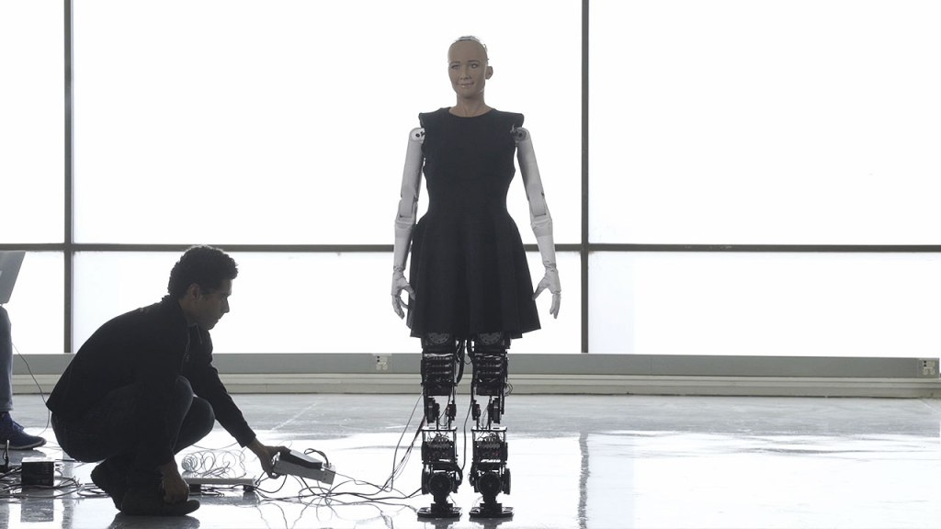
Sophia, a social humanoid robot
Developed by Hanson Robotics (Hong Kong) in 2016
Able to display more than 50 facial expressions
Ability to “see”, follow faces, recognize individuals, and sustain eye contact
Able to process speech and have a conversation using a natural language subsystem
Gives pre-written responses to a large but specific set of questions or phrases
(similar to a chatbot)
Upgraded with functional legs (January 2018)
The first robot to receive citizenship in any country (Saudi Arabia, 2017)

Slide 19
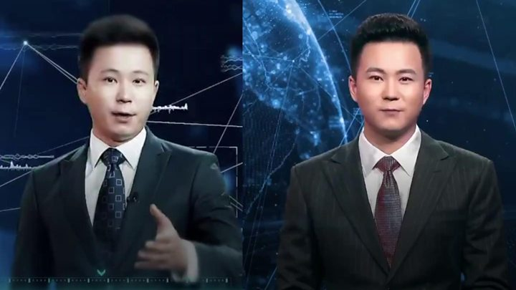
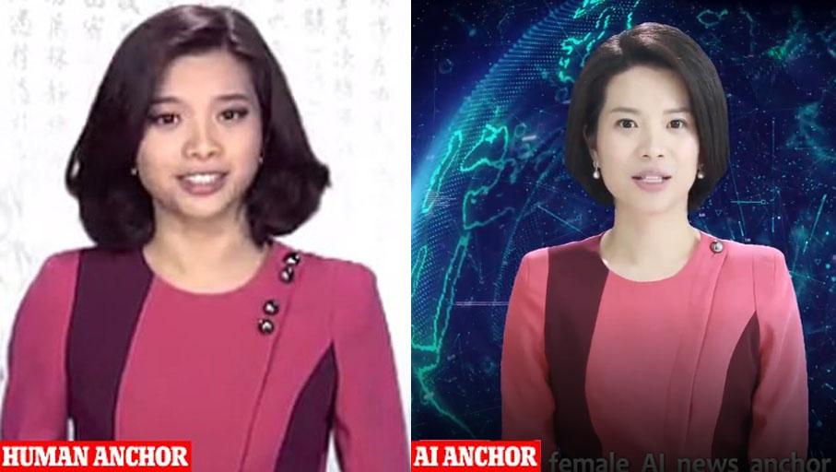
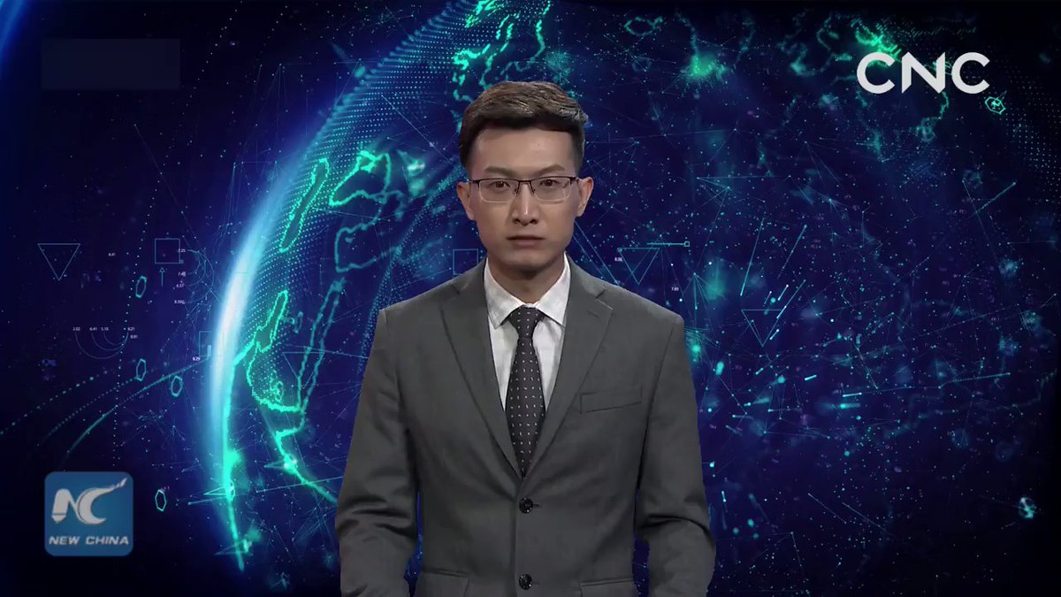
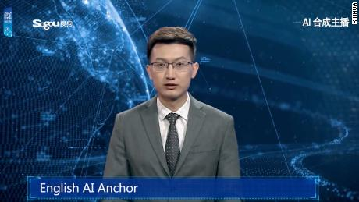
China’s A.I. News Anchors
Developed by Xinhua News Agency and Sogou
Debuted on November 7th, 2018
Modeled after real Xinhua news anchors
(Zhang Zhao and Qiu Hao)
Simulate human voices, facial expressions and gestures
Can “read texts naturally”
Learns from live broadcasting videos of itself
Notes:
The goal
Deliver news around the clock
Help reduce news production costs and improve efficiency
More importantly, they would be used to deliver breaking news at a moments notice
Recently, they created the first female news anchor, who was modeled after Xin Xiaomeng

Slide 20
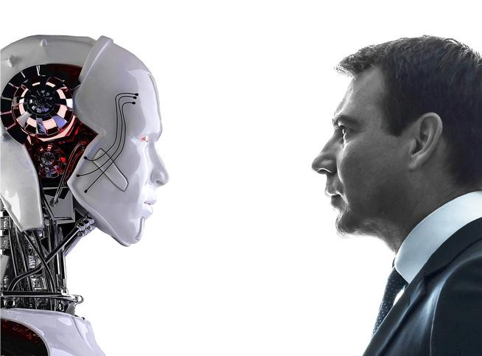
Humans vs. Machines
Humans
Transmit information at ~100 m/s
Biological neurons operate at ~200 Hz
Machines
Transmits information at ~300M m/s
Artificial neurons operate at ~3.0 GHz
Can perform 20,000 years' worth of human-level calculations and simulations in just 1 week
Notes:
Just for fun, I wanted to try and compare humans with machines
So here are some stats I was able to find
100 m/s is roughly a third the speed of sound
300 million m/s is close to the speed of light – that’s how fast electricity can move through metal
3.0 GHz, that’s 3 BILLION Hz
NOTE: A human brain is confined the space within the skull, but a machine can fill up an entire room or warehouse

Slide 21
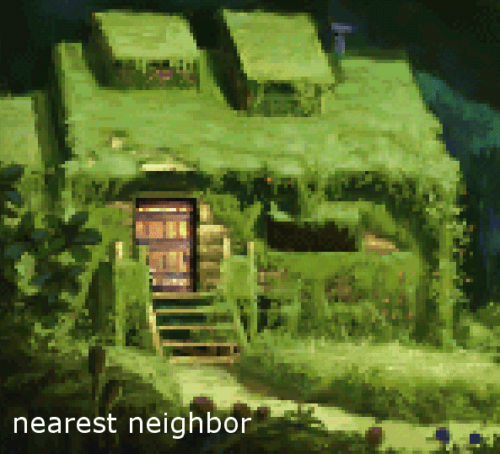
A.I. Remastered Graphics
Gamers are repurposing A.I. research for their love of video games
Discovered that machine learning is the perfect tool to remaster the graphics in old video games
Known as A.I. upscaling
Notes:
Essentially, you feed an algorithm a low-resolution image
and based on its previous training, It will return a densely packed image
This not only speeds up the previously meticulous task,
but it also tends to do a way better job.
NOTE: This does not mean that the final result will look modern or up to date.
It does however, result in objectively better graphics.
This is great for consumers because over the years, screens have been getting bigger and bigger.
The issue is that resolutions have not been able to keep up with the increasing dimensions of our devices.
But thanks to A.I. this technology can make any crappy graphics high resolution (or not get worse at the very least).

Slide 22
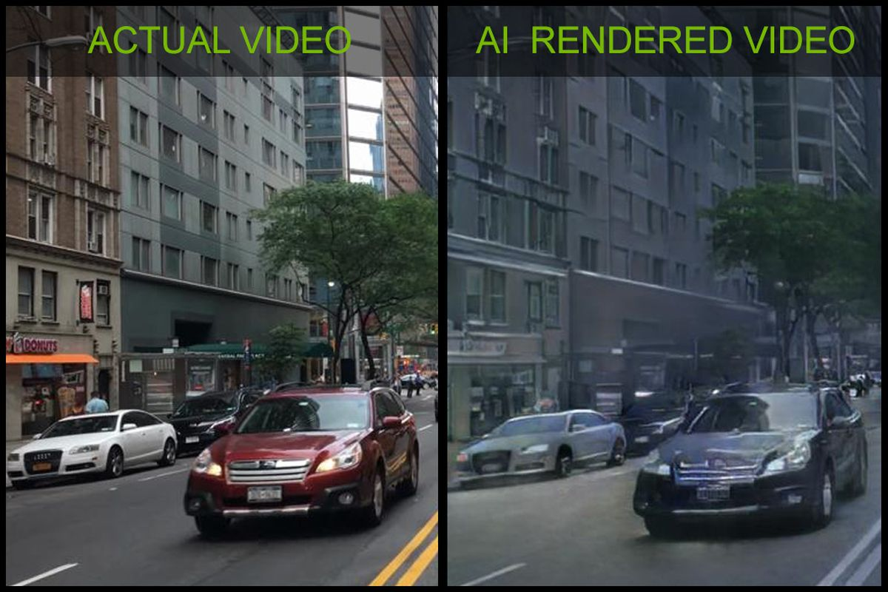
A.I. Generated Graphics
In late 2018, Nvidia created the first video game demo that used A.I. generated graphics
Driving simulator
Cannot interact with environment or leave vehicle (yet)
Uses deep learning instead of machine learning
Only uses a single graphics card to process graphics

Slide 23
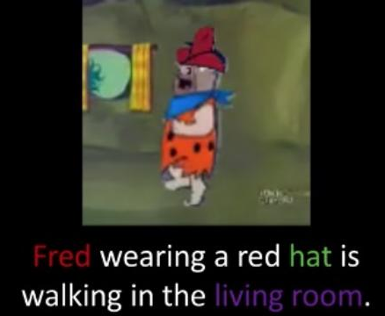
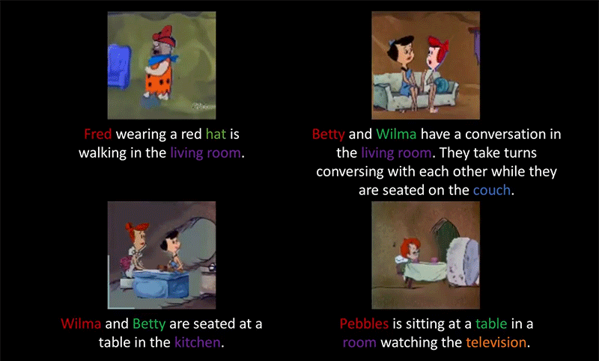
A.I. Generated Animations
Allen Institute of Artificial Intelligence at the University of Illinois Urbana – Champaign.
Successfully trained A.I. to generate new clips of the Flintstones animated series
Animations only based on random text descriptions of the scene
Quality of the animations are “awful” at best

Slide 24
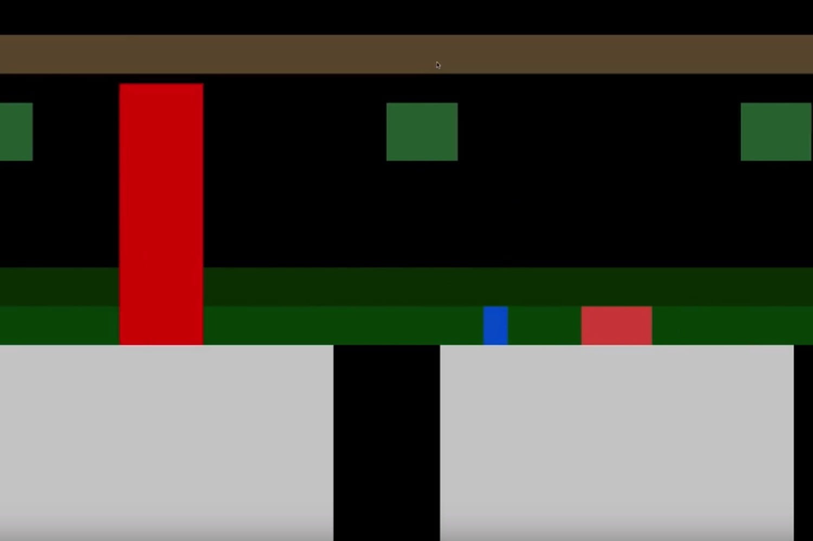
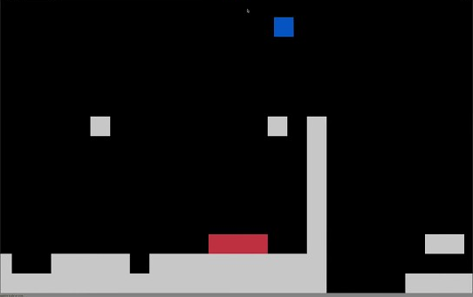
Game: Death Walls
A.I. Generated Video Games
Developed by Georgia Tech in late 2018
Showed A.I. system a video containing hours of 8-bit classic games for “inspiration”
It was then able to create brand-new video games from what it learned
Model learns each game’s level design, mechanics, and rules
Death Walls
Killer Bouncer
Game: Killer Bouncer

Slide 25
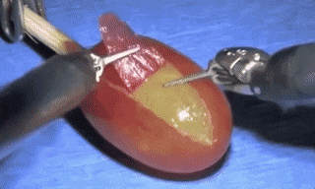
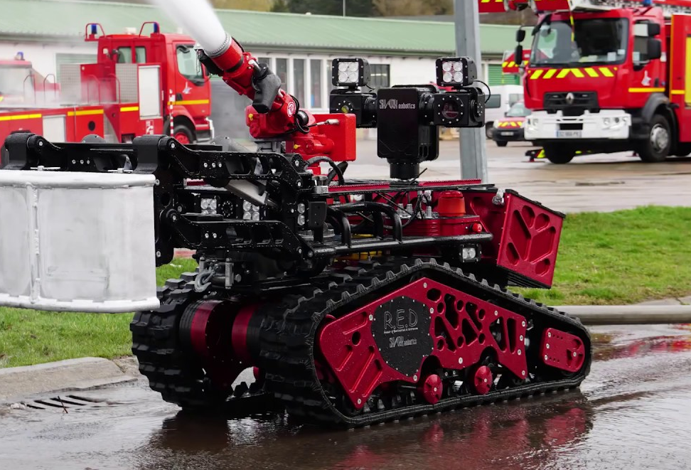
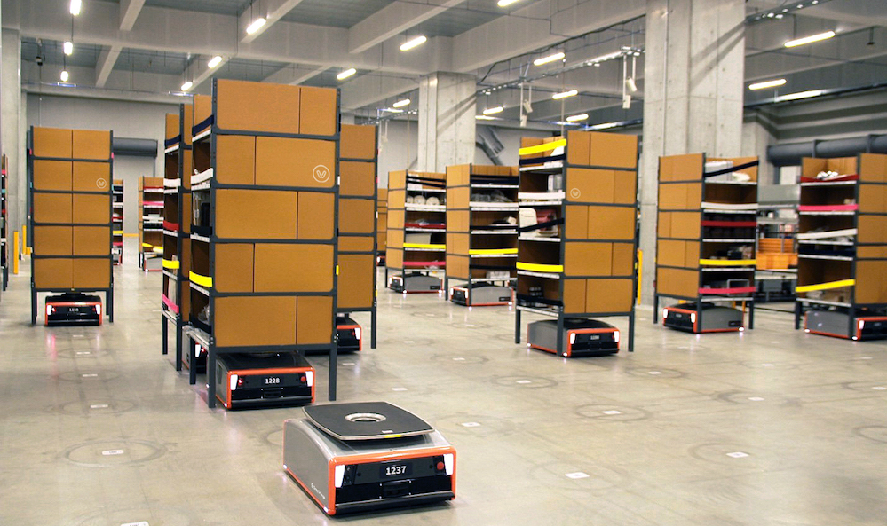
Other Applications
Improve standard of living by Taking over labor intensive or dangerous jobs
Warehouses and farms
Medical and health care
Firefighting
Discover new cures and medical procedures

Slide 26
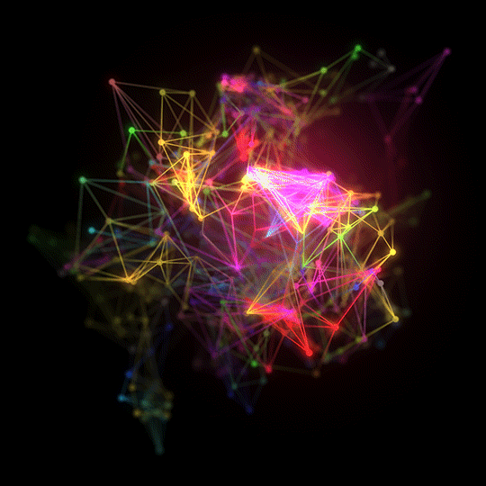
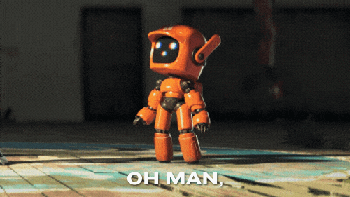
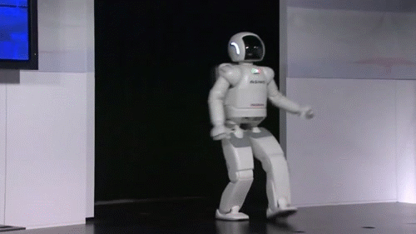
Conclusion
A.I. is already here and it’s here to stay
A.I. may have a bigger impact on the world than the internet did
For fault of a few bad apples…
Notes:
We should not be afraid of this new technology as it is being used to improve our lives.
As individuals need to do our part in understanding new technologies so that we do not live in fear of them,
and so that we know how to better use them and allow them to benefit us.
Just like the internet has helped to shape the last few decades, I believe that A.I. will be responsible for shaping next several ones.
There will always be individuals using new technologies with evil motives and personal gains in mind.
We should not let those few bad apples ruin all the good that is being done by the rest of these groups.
I hope that my presentation today has helped many of you to understand this new technology better
so that as future professionals, you can be better prepared to deal with it in whatever shape or form it may be presented to you.

